Slide 1

Tourism 4.0
Innovative technology solutions for the tourism sector

Slide 2

“The content of this report/call of expression/survey/ document represents the views of the author only and is his/her sole responsibility; it cannot be considered to reflect the views of the European Commission and/or the European Innovation Council and SMEs Executive Agency (EISMEA) or any other body of the European Union. The European Commission and the Agency do not accept any responsibility for use that may be made of the information it contains.”

Slide 3

“Tourism can be a platform for
overcoming the pandemic.
By bringing people together, tourism can promote solidarity and trust”
UN SECRETARY-GENERAL
ANTONIO GUTERRES
2020

Slide 4
Agenda
04
Introduction
PROPOSE | WHO DO WE ADDRESS? |MAIN OBJECTIVES |
WHO WE ARE?|
8
Open Call for Tourism SME’s
WHY SHOULD YOUR SME PARTICIPATE | WHAT DO WE OFFER?| STRUCTURE | HOW TO APPLY? | WHAT IS EXPECTED FROM PARTICIPATING SME’S?
20
Communication
PLANNED COMMUNICATION PLAN | BEFORE THE PROGRAM | DURING AND AFTER THE PROGRAM
24
SME’s & Startups Selection
SELECTION
26
Activity Plan
Activity Plan

Slide 5
INTRODUCTION
The project Tourism 4.0, with a budget of 1,3 M€, is co-funded by the European COSME Program and began
on 1st January 2022, while it will continue its activities up until 31st January 2024 and beyond.
The project aim is to develop a capacity building, technology transfer, support, and assistance program to enable tourism sector SMEs to adopt and leverage emerging digital technologies, to improve their productivity, sustainability, and overall business performance.
As indicated in by the European Commission, the tourism sector’s competitiveness is closely linked to its
sustainability, as the quality of tourism destinations, is strongly influenced by their natural and cultural
environment and by their integration into a local community.
In this context, Tourism 4.0 strives to promote the capacities and skills of tourism SMEs to explore and adopt
digital transformation and uptake of advanced technologies (big data analysis and management, artificial intelligence, blockchain, internet of things, augmented reality, cybersecurity, etc) by tourism SMEs through a reinforced transnational and intersectoral collaboration between SMEs and Hospitality and Travel Agencies from different tourism sectors in Italy, Portugal, Spain, Malta, Croatia, and Poland.

Slide 6


WHO DO WE ADDRESS?
SMEs from any the following tourism sectors and wishing to improve their environmental performance:
Hotels and similar accommodation
Travel Agencies & Tour Operators

Slide 7
MAIN OBJECTIVES
In essence, Tourism 4.0 seeks to promote the adaptation of European tourism SMEs toward more
developing a capacity building, technology transfer, support, and assistance program to enable tourism sector SMEs to adopt and leverage emerging digital technologies, to improve their productivity, sustainability, and overall business performance.
The main objective of the TOURISM4.0 consortium is to explore and realize synergies among the consortium partners, helping SMEs to integrate the most advanced digital solutions into their business strategies to take advantage of emerging opportunities and achieve steady sustainable growth.
Utilizing an open innovation methodology, we will promote peer learning and knowledge exchange between tourism SMEs (problem owners) and digital/innovative SMEs & startups (problem solvers).

Slide 8










WHO WE ARE?
The Tourism4.0 consortium is composed of 10 leading partners from 6 European countries (IT, PT, HR, ES, PL, MT), operating in the tourism, innovation, and business services sectors.
The consortium was established by enhancing the complementarity of the different partners, who bring with them practical experiences on the best tools to support businesses and the main needs of tourism SMEs in terms of digitization and innovation.

Slide 9
WHY SHOULD YOUR SME PARTICIPATE?
These are some of the reasons why your SME should participate in the Tourism 4.0 programme:
Increased knowledge of digital transformation within the tourism sector and facilitated access to digital transition that will allow your company to scale up its activities.
Potential competitive advantage by getting access to new technologies, new trends, and knowledge in technological tourism offer
Benefiting from the potential cost-saving opportunities that digital transition can help your company reach.
Networking and collaboration with other SMEs in your sector, business accelerators, incubators, development agencies, and other tourism industry stakeholders.
Financial support to participate in face-to-face and online capacity-building training, and matchmaking events, to receive tailored mentoring and advisory services from experts and certifying organizations.
Visibility and promotion that your company will receive by disseminating your participation and your digital performance improvements

Slide 10
WHAT DO WE OFFER?
The TOURISM 4.0 programme is built around 3 key pillars, Sustainability, Productivity and Resilience.
The open innovation programme involves training, mentoring and webinars for capacity building and knowledge transfer, matchmaking events for transnational and cross-sectoral cooperation as well as knowledge exchanges, and training and mentoring to promote the implementation of digital transition initiatives.
Your participation in our programme is free of charge as there are no registration fees for any of our activities. Therefore, we will cover 100% of the eligible costs incurred as indicated in each of the activity’s descriptions. Before you apply, please read the “important clarifications” at the end of this section
Preparation
Execution
Planning & Communication
Technology provider scouting and mentoring
Pilot’s
co-development
SME’s Scouting
Awards Event

Slide 11
STRUCTURE
Preparation
Execution
Planning & Communication
Technology provider scouting and mentoring
SME’s Scouting
Pilot’s
co-development
Awards Event
Survey to experts (Travel agencies and Hospitality) define Challenges
Identify the challenges
Training, support, knowledge-transfer
Identification of experts for advisory coaching mentoring

Slide 12
STRUCTURE
Preparation
Execution
Planning & Communication
Technology provider scouting and mentoring
SME’s Scouting
Pilot’s
co-development
Awards Event
Open call for expression of interest
Selection of startup/SME with solution for tourism sector
Mentoring, capacity building and assistance program
A rigorous and judicious selection of startups will allow you to present a set of solutions to programming partners to meet the innovation needs identified.
This selection should take into account different criteria:
• Relevance of the product/service for the tourism sector;
• Adapt to the challenges that can be defined for this edition of the program;
• Availability to participate in the various stages of development until Demonstration Day;
• Quality and technical skills of the team;
• State of solution development (it is a condition to have a Minimum Viable Product ("MVP")

Slide 13


Startups Scouting & Selection
In this way, the selection will be made as follows:
1. Analysis of startup applications with more complete information, presenting products/services demonstrate a potential adaptation to the challenges of the program. This work will be carried out together with the partners, as in the previous edition.
2. Selection of the best applications according to the classification assigned by each of the partners.
3. Interview with startups to confirm the information obtained in the application, understand business culture, as well as the potential of the solution, knowing who will manage them during the program.
4. During subsequent phases, there will also be an opportunity to filter out some of the companies or startups to ensure that the program comes to an end with teams that are focused on adding value and growing tourism.

Slide 14
STRUCTURE
Preparation
Execution
Planning & Communication
Technology provider scouting and mentoring
SME’s Scouting
Pilot’s
co-development
Awards Event
Open call for third party funding for training and assistance
Selection of 20-30 Tourism SME’s
Matchmaking SME’s

Slide 15
STRUCTURE
Preparation
Execution
Planning & Communication
Technology provider scouting and mentoring
SME’s Scouting
Pilot’s
co-development
Awards Event
Co-development of solutions
Follow up

Slide 16
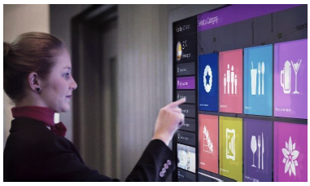
Pilots Co-development
The co-development phase will aim at working together between companies and
startups so that the latest ones implement innovative solutions that will improve
results of the first ones.
This phase of the programme will consist of three complementary parts that will accompany the progress of the
pilot projects:
Matchmaking
Problem vs Solution
Pilot

Slide 17
STRUCTURE
Preparation
Execution
Planning & Communication
Technology provider scouting and mentoring
SME’s Scouting
Pilot’s
co-development
Awards Event
European Innovation Conference awards

Slide 18
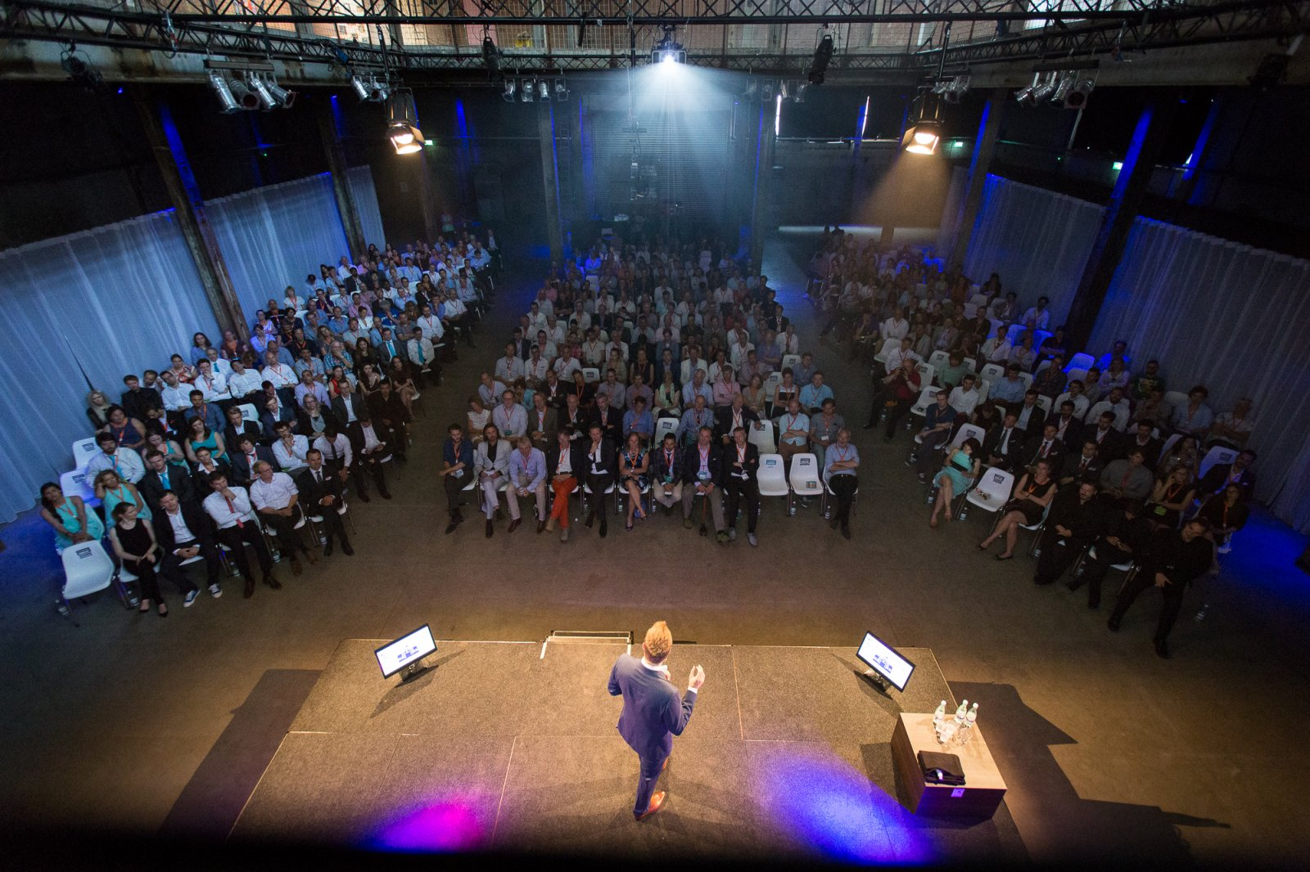
Open Innovation Award Event
Once the co-development phase is complete, companies and startups will participate in a Demo Day
and will be challenged to compile and communicate the results obtained to their customer community
(current or potential), partners, as well as the tourism and entrepreneurship ecosystem in Portugal and the rest of the world.
The goal will be for the results to reach future customers and other companies, through podcasts, blogs, publications, and the newsletter sent to the companies attending the launch event.
With the sharing of results and successful case studies, we want other companies to value and recognize these solutions, and want to implement them by leveraging the solutions developed and their impact on the ecosystem

Slide 19
HOW TO APPLY?
Before getting started, please note that we will only accept applications submitted in English.
Then, follow these steps to successfully submit your application:
1. Click on the “Apply now” button available on https://nestportugal.pt/resources/tourism-40/
2. Fill out all sections of the application form.
3. Accept the privacy policy at the end of the form.
4. Click on “Submit”.
5. You will receive a confirmation e-mail with a copy of your answers (check the spam folder too). If you do not, please contact us at nest@innovtourism.pt
The deadline for application is on 27.06.2022 at 17:00 CET

Slide 20
WHAT IS EXPECTED FROM PARTICIPATING SME’S?
During our programme, we would require only a few things from your SME:
Your active participation in the programme’s activities.
Report on data that will allow us to monitor your sustainability performance. We will provide you with a simple template to be filled out periodically.
Allow us to access and use such data, and publicly disseminate the results.
Provide us with basic information about your company such as logo, description and contact information to publicly disseminate on our website and thus facilitate potential matchmaking between your company, other tourism service providers, certifying organisations, sustainable solution experts, etc.
Keep and send invoices and payment statements of the costs you incur in during our programme.
Your commitment to improving your SME’s digital performance in:
Improve customer experience
Develop environmental sustainability tools
Obtain and maintain quality of service parameters/improve automated operations
Improve Booking and revenue management
Improve communication and digital marketing with customers
Give visibility to the TOURISM 4.0 project and EU funding while participating in the programme. We will provide you with a standard sticker showcasing the project’s logo and EU emblem and disclaimer to be visibly placed in your establishment (window, counter, etc.). Indications for dissemination on social media will also be provided (hashtags, keywords, etc.).

Slide 21
Communication

Slide 22
PLANNED COMMUNICATION PLAN
Dissemination before, during, and after the program will play a key role in the impact of the results achieved on the ecosystem.
Firstly, we intend to leverage all the communication channels of Tourism 4.0 Partners, among the whole community, which includes the current corporate network, which includes partners relevant in the area of Tourism.
In addition, the communication strategy also aims to reach different targets, before, during, and after the program, as detailed in the slides.

Slide 23
BEFORE THE PROGRAM
Target | SME’s in Tourism | Startups
Proposal | For these companies, we will publicize with industry associations and some national and regional tourism delegations and associations of Travel Agencies and Hospitality. | The program will be released by different players national and international from Tourism 4.0 COSME project. Will be send it also through personalized emails for startups with which we already have contact. Our target audience will be startups or technological SME’s that already have their product developed, and which they intend to expand to a new line of business, hospitality and travel agencies in Europe.

Slide 24
DURING AND AFTER THE PROGRAM
The program will be accompanied by a Tourism 4.0 website updated periodically with the relevant developments and with the participants who will be selected at each stage. The content generated during the main moments of the program (launch, intermediate event, and Demo Day) will be also shared on social networks (Linkedin, Facebook, Instagram), and periodic press releases will be sent to the media
We will also focus on capturing photos and videos that will make it possible to more dynamically feed shared content and make it easier to disclose future editions.
Once the program is completed, it will once again be essential to disseminate the results obtained to leverage the solutions developed to be implemented in different companies, thus enhancing the evolution, growth, and digitization of Tourism in EUROPE. This disclosure will use the same means used since the beginning of the program: newsletter, social networks, blog posts, and press releases, for the press.

Slide 25
Selection Criteria

Slide 26
SELECTION
STARTUPS | SME’s (Travel Agencies and Hospitality)
- Solution presented; - Potential impact of the solution in the tourism; - Relevance of the problem that the solution can solve; - Ambition to develop your business in the area of tourism; - Motivation for the application to the program; - Team experience; - Ability to work in groups, receive feedback and co-develop with another company; - Flexibility, adaptation, and problem solving | - Relevance, impact and scalability of the challenge presented for co-development with a startup; - Potential for creating a relevant and scalable solution not only for the challenge presented but also for the tourism sector; - Maturity of the company/ Time of existence; - Team experience; - Motivation and relevance of the objectives presented for participation in the programme; - Ability to work in groups, receive feedback and co-develop a solution with a startup; - Flexibility, adaptation and problem solving

Slide 27
Activity Plan

Slide 28
ACTIVITY PLAN
Project Management
• Full-time Program Manager to manage the startups and all the stakeholders of the Program;
Knowledge
• Workshops delivery: 15 workshops are delivered during the Program;
• Mentors Office Hours: minimum of 20 mentorship sessions with relevant experts;
Communication & Production
• Communication Plan design, including social media activation and blog content;
• Activation of Tourism 4.0 international referral network;
• Event and production management: roadmap, program design, venue setup;

Slide 29
Thank You

